Slide 1
Placement Management System (Company Module)
A project presentation
for the subject of
060060612: DSE10 Project (PW)
Presented on : 13/04/2020
By:
201706100610037 : yash h. kataria
201706100610024 : Praneet m. kaisare
201706100610055 : pulkit s. Bhagwate
201706100610021 : Abdulla a. Shaikh

Slide 2
Identification of Need
Biggest challenges of higher learning institutions
to improve the placement performance of students.
Complex and tedious task for the institutes placement committee
manual work of student’s placement in a company and scheduling of all the interviews
Placement Management System
Provide an interface availing the recruitment facilities to students.
Based on the interest shortlisting and schedules are prepared for student’s as well as companies.

Slide 3
Proposed System : Definition
The Placement Management System (Company Module) is developed to ensure that the company gets an opportunity to select eligible students from the institute for internship/placement in their organizations based on criteria defined on technology, formal agreement, office timing etc.

Slide 4
Proposed System : Objective
The objective of this module is to provide an interface to the companies where they can
manage their company’s basic details, their offerings (stipend, package, tenure) details, recruitment parameters to check student’s eligibility.
The schedule managed by placement committee are a point of choice for confirming dates of interview.

Slide 5
Proposed System : Scope
The scope of the proposed system is limited to the company module
which will assist the student and the feedback analysis module accordingly.
The system shall be able to
manage company details, generate schedules and attendance of the interview and generate various statistical reports for analysis.

Slide 6
User & Roles
Admin :-
Managing Company Details.
Managing Companies Short-listing Criteria.
Configuring Invites.
Categorizing Companies.
Generating Short-list.
Generating Schedules.
Managing Interview Attendance.
Configure Alerts.
Procuring Feedbacks.
Managing Student Rounds Details.

Slide 7
User & Roles
Company :-
Registration.
Login.
Update profile.
Request shortlisted students according to criteria.
Short-list Students.
View student details.
Post Results.

Slide 8
Proposed System : Expected Requirements
Maintain the company's profile.
Maintain the company repository.
Configure the invitation for the companies.
Categorize companies based on parameters matching with companies with student's parameters.
Manage companies' short-listing criteria.
Generating schedules.
Maintain Interview Attendance.
View feedback.
Generating short-lists of company.
Manage student round mark details.

Slide 9
Proposed System : Expected Requirements (cont..)
Registration.
Login.
Update profile.
Request particular student details (Resume/ Other related data).
Request shortlisted students according to criteria.
View shortlist student details.
Post Results.

Slide 10
Proposed System : Exciting Requirements
Maintaining N-years records of the company’s details.
Generating Schedule of the interview while prioritizing companies according to higher stipend and package amount.

Slide 11
Overview of coding Specification
appropriate prefix for each of the UI elements :-
Control | Prefix | Control | Prefix
Label | lbl | CheckBoxList | cbl
TextBox | txt | RadioButton | rdb
DataGrid | dg | RadioButtonList | rbl
Button | btn | Image | img
ImageButton | imb | Panel | pnl
Hyperlink | hl | PlaceHolder | ph
DropDownList | ddl | Table | tbl
Gridview | grd | Repeater | rep
DataList | dl | Checkbox | cbx

Slide 12
System Design : Data Dictionary with Constraints 1. tbl_Company_Basic_Details
Field Name | Data Type | Size | Constraints | Valid input values | Description Of the field | Linkage with other tables
Company_Id | int |  | PRIMARY KEY, NOT NULL, AUTO_INCREMENT | 101 | Represent’s the unique id of Company
Email_Id | varchar | 320 | PRIMARY KEY, NOT NULL, AUTO_INCREMENT | microsoft@gmail.com | Represent’s company’s Email Id
Company_Name | varchar | 50 | NOT NULL | Microsoft | Represent's the company name
Contact_Number | varchar | 14 | NOT NULL | +918140048489 | Represent's Company Contact Number
Company_State | varchar | 15 | NOT NULL | Gujarat | Represent’s company’s location situated in which State
Company_City | varchar | 25 | NOT NULL | Surat | Represent’s company’s location situated in which City
Company_Address | varchar | 150 | NOT NULL | Rami Park, Adajan, Surat | Represent's location of the company
Company_Representative1_Name | varchar | 50 | NOT NULL | Mr. Siddharth Bhatt | Represent’s Company’s Representative (HR)
[continue]

Slide 13
Field Name | Data Type | Size | Constraints | Valid input values | Description Of the field | Linkage with other tables
Company_Representative2_Name | varchar | 50 |  | Mr. Meet Shah | Represent’s Company’s Representative (HR Assistant)
Password | varchar | 16 | NOT NULL | Abc@123 | Company password must contain Alphanumeric & Special character
Company_Website | varchar | 30 |  | http://suratinfotech.com | Company website link
Company_Logo | image |  |  | - | Display company logo

Slide 14
2. tbl_Company_Offerings
Field Name | Data Type | Size | Constraints | Valid input values | Description Of the field | Linkage with other tables
Company_Id | int |  | PRIMARY KEY, NOT NULL, FOREIGN KEY | 101 | Represent’s the unique id of Company | tbl_Company_Basic_Details(Company_Id)
Selection_Mode | tinyint |  | NOT NULL | 1=On Compus 0=Off Compus | Represent’s the mode of placement company provides
Stipend | float |  | NOT NULL | 10000.00 | Represent’s how much stipend the company will provide
Package | float |  | NOT NULL | 1000000.00 | Represent's how many packages the company will provide
Tenure | tinyint |  | NOT NULL | 2 | Represent’s how much Tenure duration the company will provide
Estimate_Arrival_Date_From | date |  | NOT NULL | 2019-09-17 | Estimate Arrival Date of Company From
Estimate_Arrival_Date_To | date |  | NOT NULL | 2019-09-17 | Estimate Arrival Date of Company To
Estimate_Required_Student | tinyint |  | NOT NULL |  | Represent how many Student required (Approx)
Company_Total_Rounds | int |  | NOT NULL | - | Represent’s Company’s Total Rounds
Last_Updated_Year | int |  | NOT NULL | 2020 | Represent’s Company Last Updated year

Slide 15
3. tbl_Technology
Field Name | Data Type | Size | Constraints | Valid input values | Description Of the field | Linkage with other tables
Technology_Id | int |  | PRIMARY KEY, NOT NULL, AUTO_ INCREMENT | 101 | Represent’s the unique id for Technology
Technology_Name | varchar | 50 | NOT NULL | ASP.NET | Represent’s the Technology Name
4. tbl_Company_Required_Technology
Field Name | Data Type | Size | Constraints | Valid input values | Description Of the field | Linkage with other tables
Technology_Id | int |  | PRIMARY KEY, NOT NULL, AUTO_INCREMENT | 101 | Represent’s the unique id for Technology | tbl_Company_Basic_Details(Technology_Id)
Company_Id | int |  | PRIMARY KEY, NOT NULL,FOREIGN KEY | 101 | Represent’s the unique id of Company | tbl_Company_Basic_Details(Company_Id)
Updation_Time | datetime |  | NOT NULL | 19/02/2019 | Represent’s Updation Time

Slide 16
5. tbl_Admin_Login
Field Name | Data Type | Size | Constraints | Valid input values | Description Of the field | Linkage with other tables
Admin_Id | int |  | PRIMARY KEY, NOT NULL, | 101 | Represent’s the unique id of Admin
Admin_Name | varchar | 50 | NOT NULL | Ms. Poonam Godhwani | Represent’s the Name of Admin
Email_Id | varchar | 320 | NOT NULL | Poonam.godhwani@utu.ac.in | Represent’s the Admin Email Id
Password | varchar | 16 | NOT NULL | Abc@123 | Admin password must contain Alphanumeric & Special character
6. tbl_Interview_Attendance
Field Name | Data Type | Size | Constraints | Valid input values | Description Of the field | Linkage with other tables
Company_Id | int |  | PRIMARY KEY, NOT NULL, FOREIGN KEY | 101 | Represent’s the unique id of Company | tbl_Company_Basic_Details(Company_Id)
Student_Id | bigint |  | PRIMARY KEY, NOT NULL, FOREIGN KEY | 201706100610037 | Represent’s the unique id for Student | tbl_Student_Basic_Details(Student_Id)
Status | varchar | 8 | NOT NULL | Present | Represent's whether the student is present for interview or not

Slide 17
7.tbl_Shortlist_Criteria
Field Name | Data Type | Size | Constraints | Valid input values | Description Of the field | Linkage with other tables
Company_Id | int |  | PRIMARY KEY, NOT NULL, FOREIGN KEY | 101 | Represent’s the unique id of the Company | tbl_Company_Basic_Details(Company_Id)
Under_Graduation_Degree_Type | varchar | 50 | NOT NULL | BCA | Represent’s the Under-Graduation degree type
Post_Graduation_Degree_Type | varchar | 50 | NOT NULL | MCA | Represent’s the Post-Graduation degree type
SSC_Percentage | float |  | NOT NULL | 95.00 | Represent’s SSC Percentage of Student required
HSC_Percentage | float |  | NOT NULL | 95.00 | Represent’s HSC Percentage of Student required
SGPA | float |  | NOT NULL | 9.65 | Represent Cummulative SGPA of Student required
CGPA | float |  | NOT NULL | 9.65 | Represent OverAll Cummulative CGPA of Student required
Additional_Technology | varchar | 50 |  | ASP.NET | Represent’s Additional Technology
Allow_KT | tinyint |  | NOT NULL | 1 | Represent’s Allow KT Accept by the Company

Slide 18
8. tbl_Generate_Schedule
Field Name | Data Type | Size | Constraints | Valid input values | Description Of the field | Linkage with other tables
Schedule_Id | int |  | PRIMARY KEY, NOT NULL, AUTO_INCREMENT | 501 | Represent ‘s the unique id for schedule
Company_Id | int |  | PRIMARY KEY, NOT NULL, FOREIGN KEY | 101 | Represent’s the unique id of Company | tbl_Company_Basic_Details(Company_Id)
Student_Id | bigint |  | PRIMARY KEY, NOT NULL, FOREIGN KEY | 201706100610037 | Represent’s the unique id for Student | tbl_Student_Basic_Details (Student_Id)
Interview_Mode | tinyint |  | NOT NULL | 1=On-Campus 0=Off-Campus | Represent’s the mode of the interview to be conducted
Interview_Mode | varchar | 20 | NOT NULL | On-Campus/Off-Campus | Represent’s the mode of the interview to be conducted
Interview_Venue | varchar | max | NOT NULL | Shrimad Hall, SRIMCA, UTU | Represent’s the venue for the interview to be conducted
Arrival_Time | datetime |  | NOT NULL | 2019-08-12 08:30:00 | Represent’s Arrival timing of the company
Interview_Details | varchar | max |  | - | Represent’s Interview Details

Slide 19
9. tbl_Interview_Results
Field Name | Data Type | Size | Constraints | Valid input values | Description Of the field | Linkage with other tables
Company_Id | int |  | PRIMARY KEY, NOT NULL, FOREIGN KEY | 101 | Represent’s the unique id of Company | tbl_Company_Basic_Details(Company_Id)
Student_Id | bigint |  | PRIMARY KEY, NOT NULL, FOREIGN KEY | 201706100610037 | Represent’s the unique id for Student | tbl_Student_Basic_Details (Student_Id)
Status | varchar | 8 | NOT NULL | Select | Represent’s whether the student is selected or rejected
Final_Stipend | float |  |  | 10000 | Represent’s how much final stipend the company will provide
Final_Package | float |  |  | 800000 | Represent’s how much final package the company will provide
Final_Tenure | tinyint |  |  | 10000 | Represent’s how much final tenure duration the company will provide

Slide 20
10. tbl_Invitation
Field Name | Data Type | Size | Constraints | Valid input values | Description Of the field | Linkage with other tables
Company_Email_Id | varchar | 320 | PRIMARY KEY, NOT NULL | katariayash 007@gmail.com | Represent’s the unique Email id for Company
Company_Name | varchar | 50 | NOT NULL | Microsoft | Represent’s the Company Name
Status | tinyint |  | NOT NULL | 1=Accepted, 2=Denied | Represent’s Company’s Interest
11. tbl_Company_BlackList_Status
Field Name | Data Type | Size | Constraints | Valid input values | Description Of the field | Linkage with other tables
Company_Id | int |  | PRIMARY KEY, NOT NULL, FOREIGN KEY | 101 | Represent’s the unique id of Company | Company_ Basic_Details (Company_Id)
Company_BlackList_Status | varchar | 3 | NOT NULL | No | Represent’s the Company Blacklist Status

Slide 21
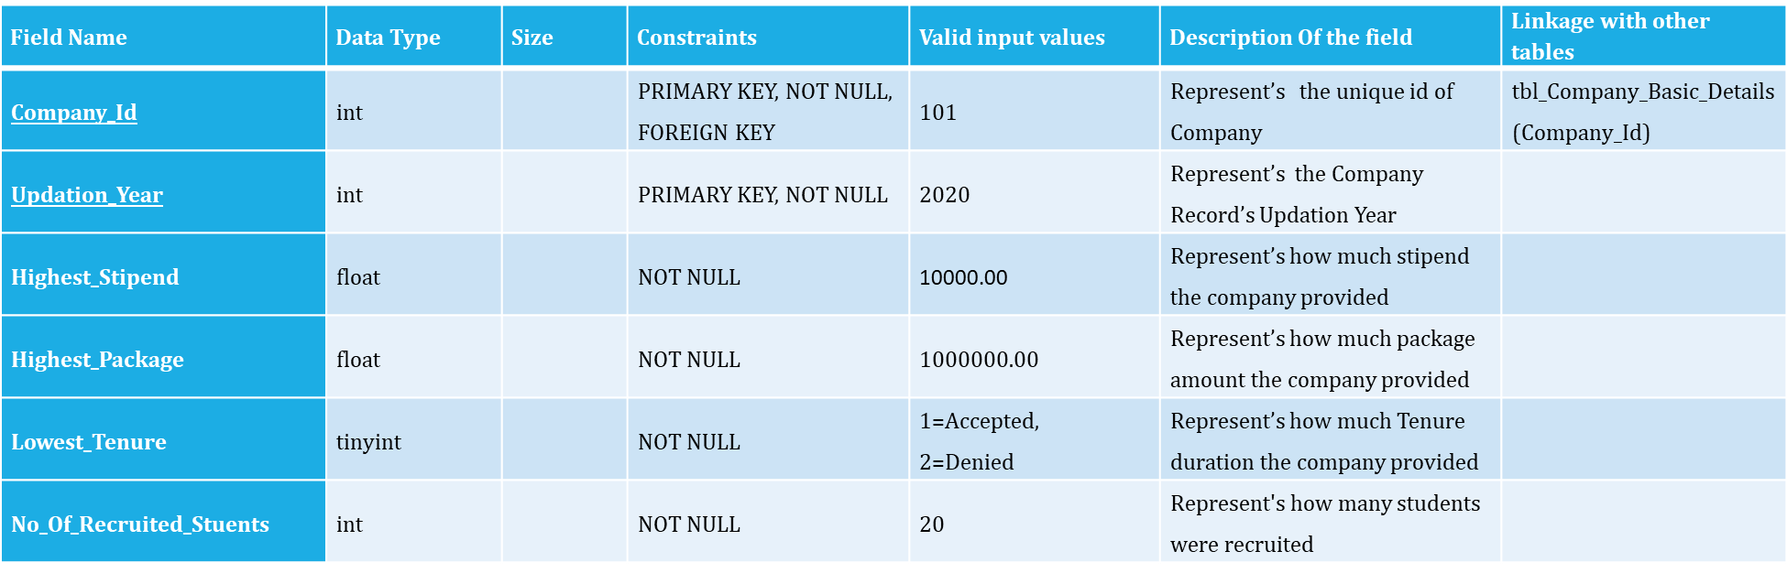
12. tbl_Company_Past_Records
[continue]

Slide 22
13. tbl_Student_Round_Details
Field Name | Data Type | Size | Constraints | Valid input values | Description Of the field | Linkage with other tables
Round_Id | int |  | PRIMARY KEY, NOT NULL | 101 | Represent’s the unique id of Round
Student_Id | bigint |  | PRIMARY KEY, NOT NULL, FOREIGN KEY | 201706100610037 | Represent’s the unique id for Student | tbl_Student _Basic_Details (Student_Id)
Company_Id | int |  | PRIMARY KEY, NOT NULL, FOREIGN KEY | 101 | Represent’s the unique id of Company | tbl_Company_Ba sic_Details (Company_Id)
Round1_Marks | float |  |  | 60.00 | Represent’s Round 1 Mark
Round1_Status | varchar | 20 |  | Completed | Represent’s Round 1 Mark Status
Round2_Marks | float |  |  | 60.00 | Represent’s Round 2 Mark
Round2_Status | varchar | 20 |  | Completed | Represent’s Round 2 Mark Status
Round3_Marks | float |  |  | 60.00 | Represent’s Round 3 Mark
Round3_Status | varchar | 20 |  | Completed | Represent’s Round 3 Mark Status
Round4_Marks | float |  |  | 60.00 | Represent’s Round 4 Mark
Round4_Status | varchar | 20 |  | Completed | Represent’s Round 4 Mark Status

Slide 23
14. tbl_Company_Alerts
Field Name | Data Type | Size | Constraints | Valid input values | Description Of the field | Linkage with other tables
Alert_Id | int |  | PRIMARY KEY, NOT NULL | 101 | Represent’s the unique id of alert
Company_Id | int |  | PRIMARY KEY, NOT NULL, FOREIGN KEY | 101 | Represent’s the unique id of Company | tbl_Company_Ba sic_Details (Company_Id)
Company_Email_Id | varchar | 320 | PRIMARY KEY, NOT NULL | katariayash 007@gmail.com | Represent’s the unique Email id for Company
Subject | varchar | 100 | NOT NULL | Placement Management System Alert | Represent’s Subject of Alert
Message | varchar | MAX | NOT NULL | Hello Alert for confirmation of Registration in the Placement Management System of Srimca. | Represent’s Message of Alert
Alert_Time | datetime |  | NOT NULL | 2/6/2020 10:49:26 AM | Represent’s Alert Time of Alert

Slide 24
15. tbl_Student_Basic_Details
Field Name | Data Type | Size | Constraints | Valid input values | Description Of the field | Linkage with other tables
Student_Id | bigint | - | PRIMARY KEY, NOT NULL | 201706100610037 | This field represents the unique ID of an Student
Student_Name | varchar | 50 | NOT NULL | Yash Himmat Kataria | This field represents student full name
Student_Pincode | int | - | NOT NULL | 394325 | This field represents pincode of student
Student_House_Number | varchar | 15 | NOT NULL | A-104 | This field represents House Number of student
Student_Society_Name | varchar | 50 | NOT NULL | Omsai Society | This field represents Society name of student
Student_Street_Name | varchar | 50 | NOT NULL | Kamrej Road | This field represents Street Name of student
Student_Locality | varchar | 30 | NOT NULL | kamrej | This field represents Student of student
Student_Id | bigint | - | PRIMARY KEY, NOT NULL | 201706100610037 | This field represents the unique ID of an Student
Student_Name | varchar | 50 | NOT NULL | Yash Himmat Kataria | This field represents student full name
Student_Pincode | int | - | NOT NULL | 394325 | This field represents pincode of student
Student_House_Number | varchar | 15 | NOT NULL | A-104 | This field represents House Number of student
[Continue]

Slide 25
Field Name | Data Type | Size | Constraints | Valid input values | Description Of the field | Linkage with other tables
Student_city | varchar | 25 | NOT NULL | Surat | This field represent city of student
Student_State | varchar | 15 | NOT NULL | Gujrat | This field represent state of student
Student_BirthDate | date | - | NOT NULL | 25-11-1999 | This field represent of birthday of student
Student_Gender | varchar | 6 | NOT NULL | Male | This field represent of gender of student
Student_Phone_No | varchar | 14 | NOT NULL | +91 9727885713 | This field represent the student phone number
Student_Email_Id | varchar | 320 |  | katariayash007@gmail.com | This firld represent the email id of a student
Student_UG_Course | varchar | 9 | NOT NULL | UG Course | This field represent course of student
Student_city | varchar | 25 | NOT NULL | Surat | This field represent city of student
Student_State | varchar | 15 | NOT NULL | Gujrat | This field represent state of student
Student_BirthDate | date | - | NOT NULL | 25-11-1999 | This field represent of birthday of student
Student_Gender | varchar | 6 | NOT NULL | Male | This field represent of gender of student
Student_PG_Course | varchar | 9 | NOT NULL | PG Course | This field represent course of student
Student_Password | varchar | 16 | NOT NULL | Kunj@2511 | This field represent student password
Student_Photo | image | - | Not null | - | This field represents the photo of the student.
Year | varchar | 5 | NOT NULL | 2020 | This field represents Year of Register of student

Slide 26

Screenshots 1. Login

Slide 27


2. Forgot Password

Slide 28

3. Reset Password

Slide 29
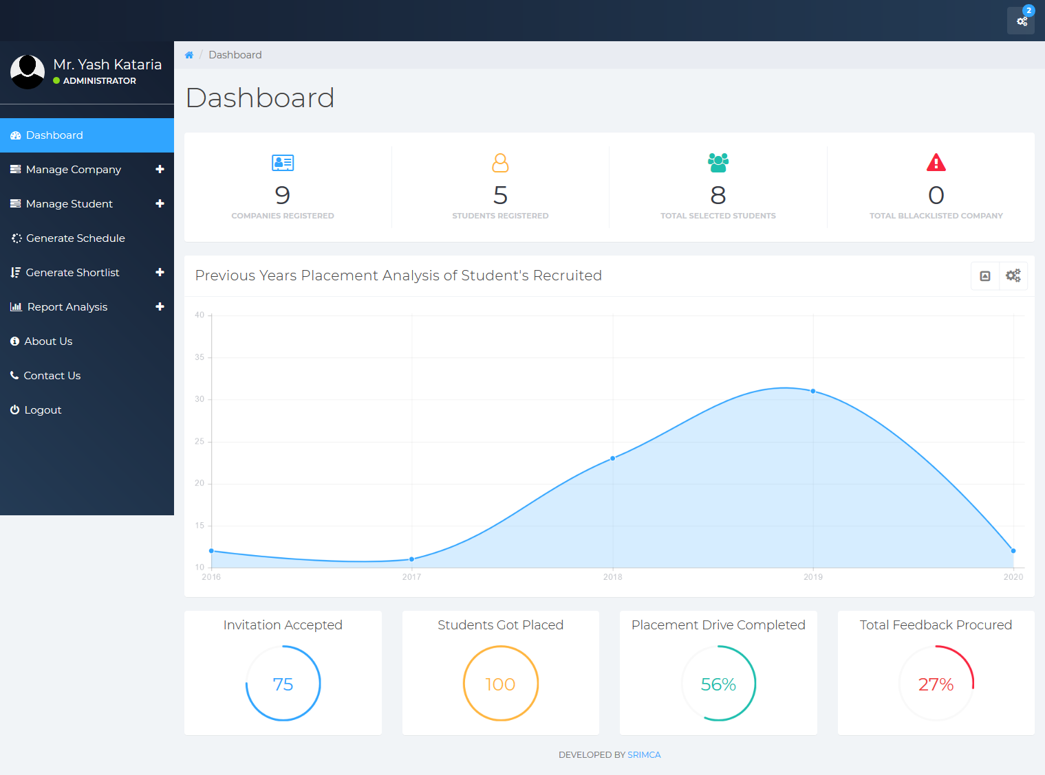
4. Administrator Dashboard

Slide 30
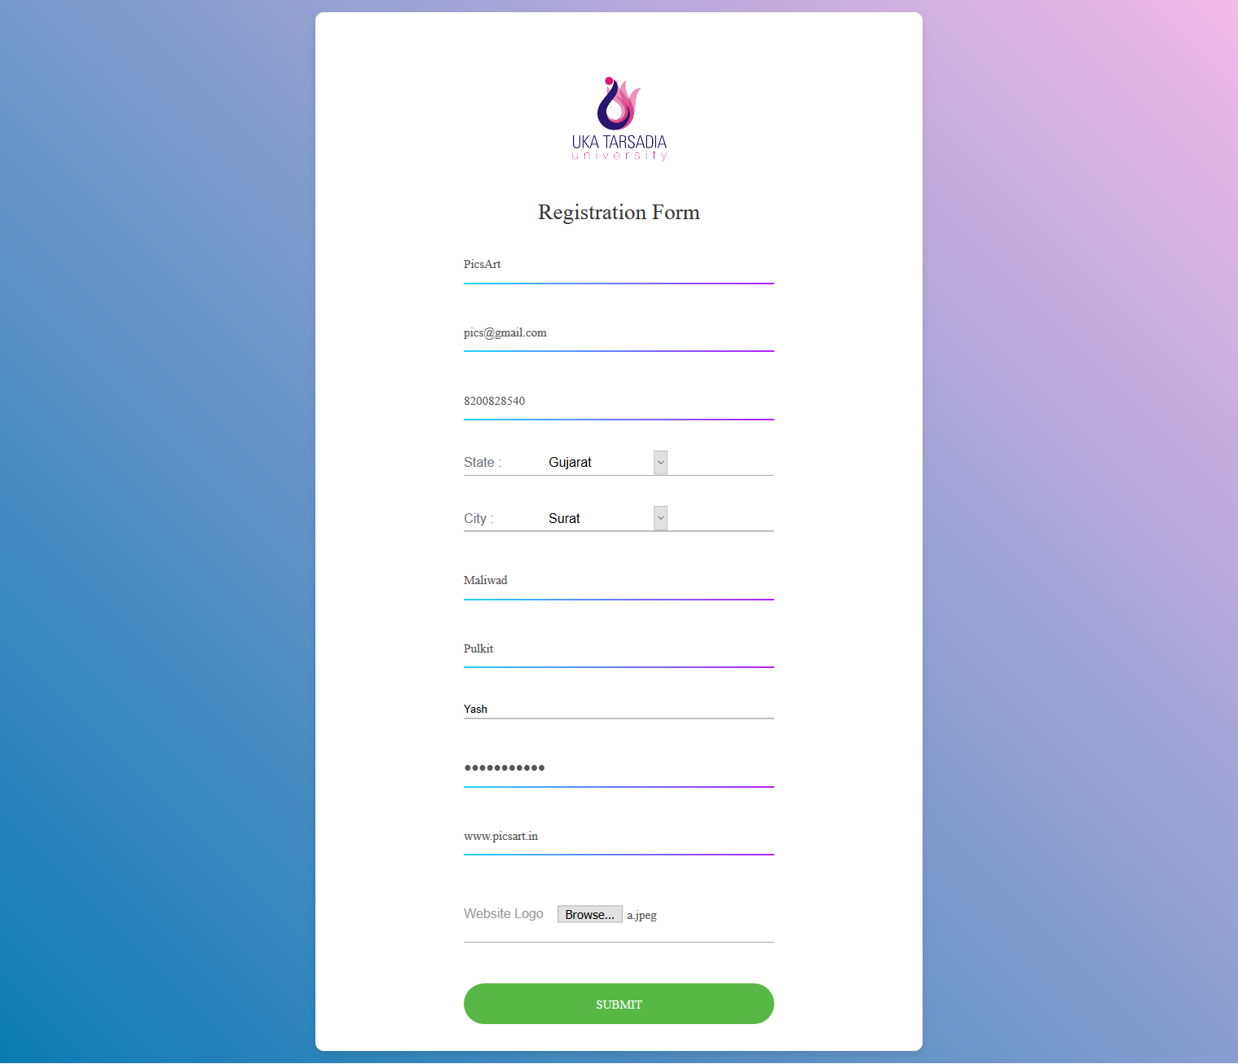
5. Registration(Company Basic Details)

Slide 31
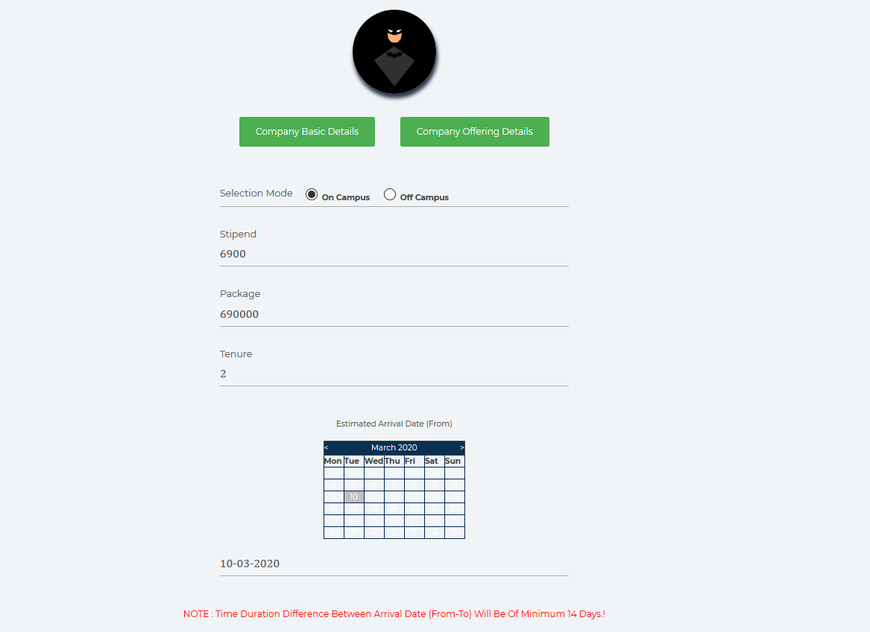
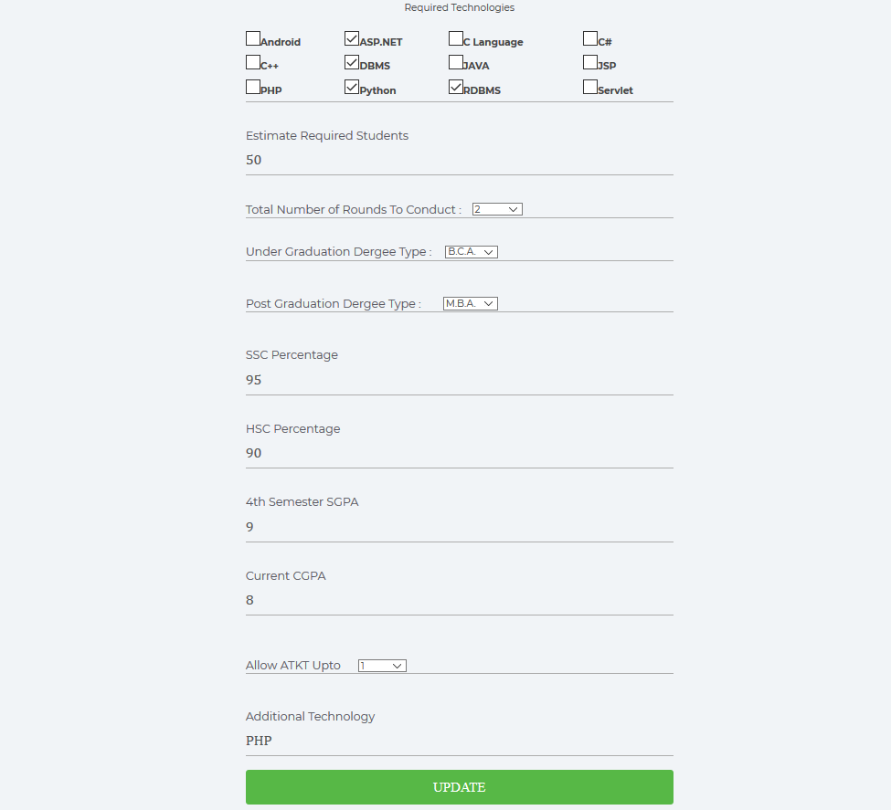
6. Registration(Company Offerings Details)

Slide 32
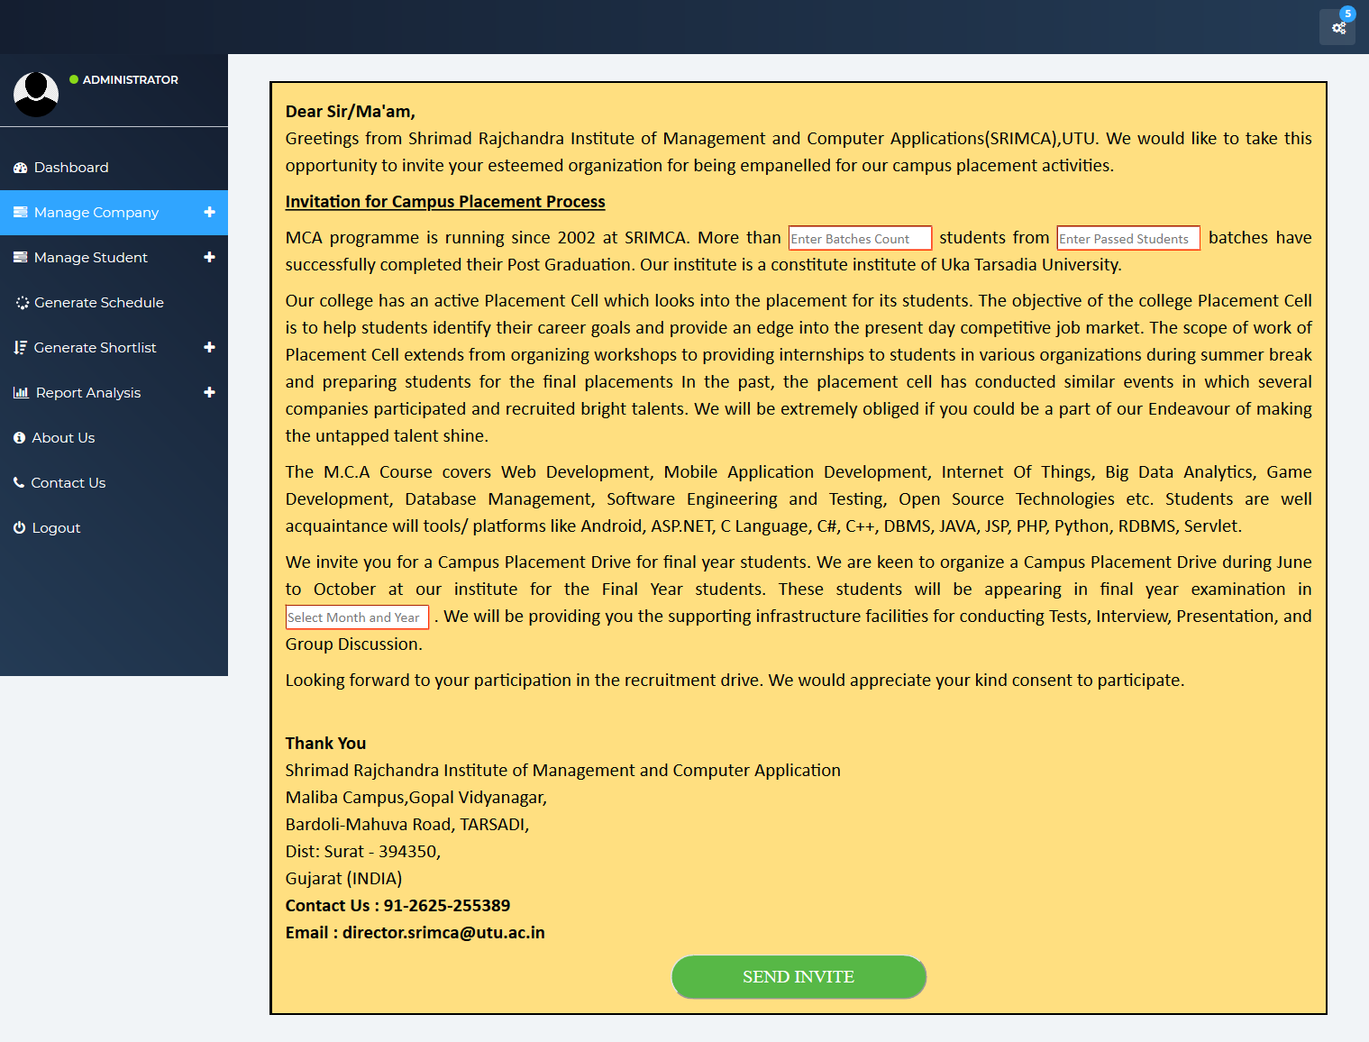
7. Admin Configure Invites(Admin Side)

Slide 33
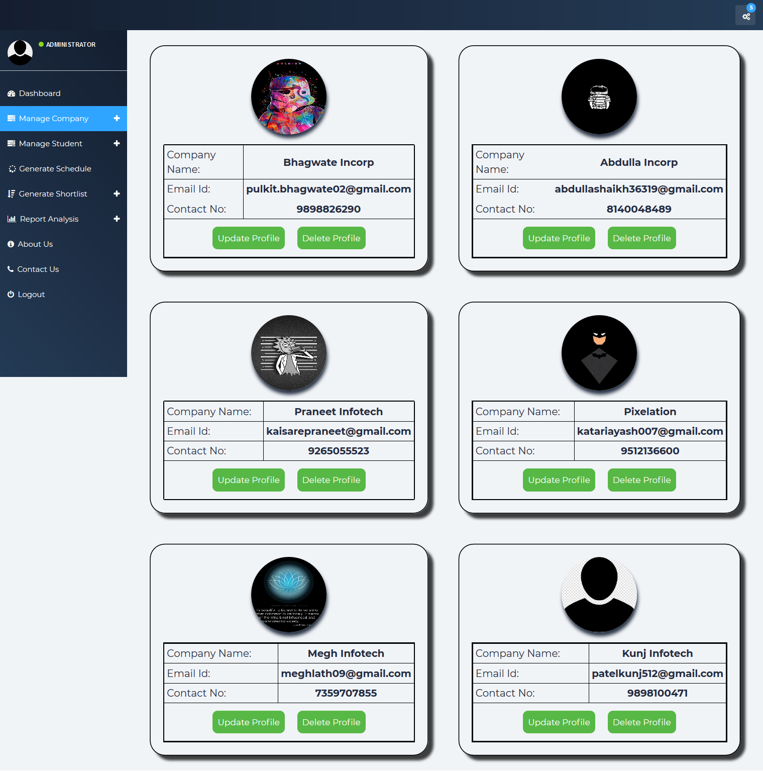
8. Manage Profile’s(Admin Side)

Slide 34
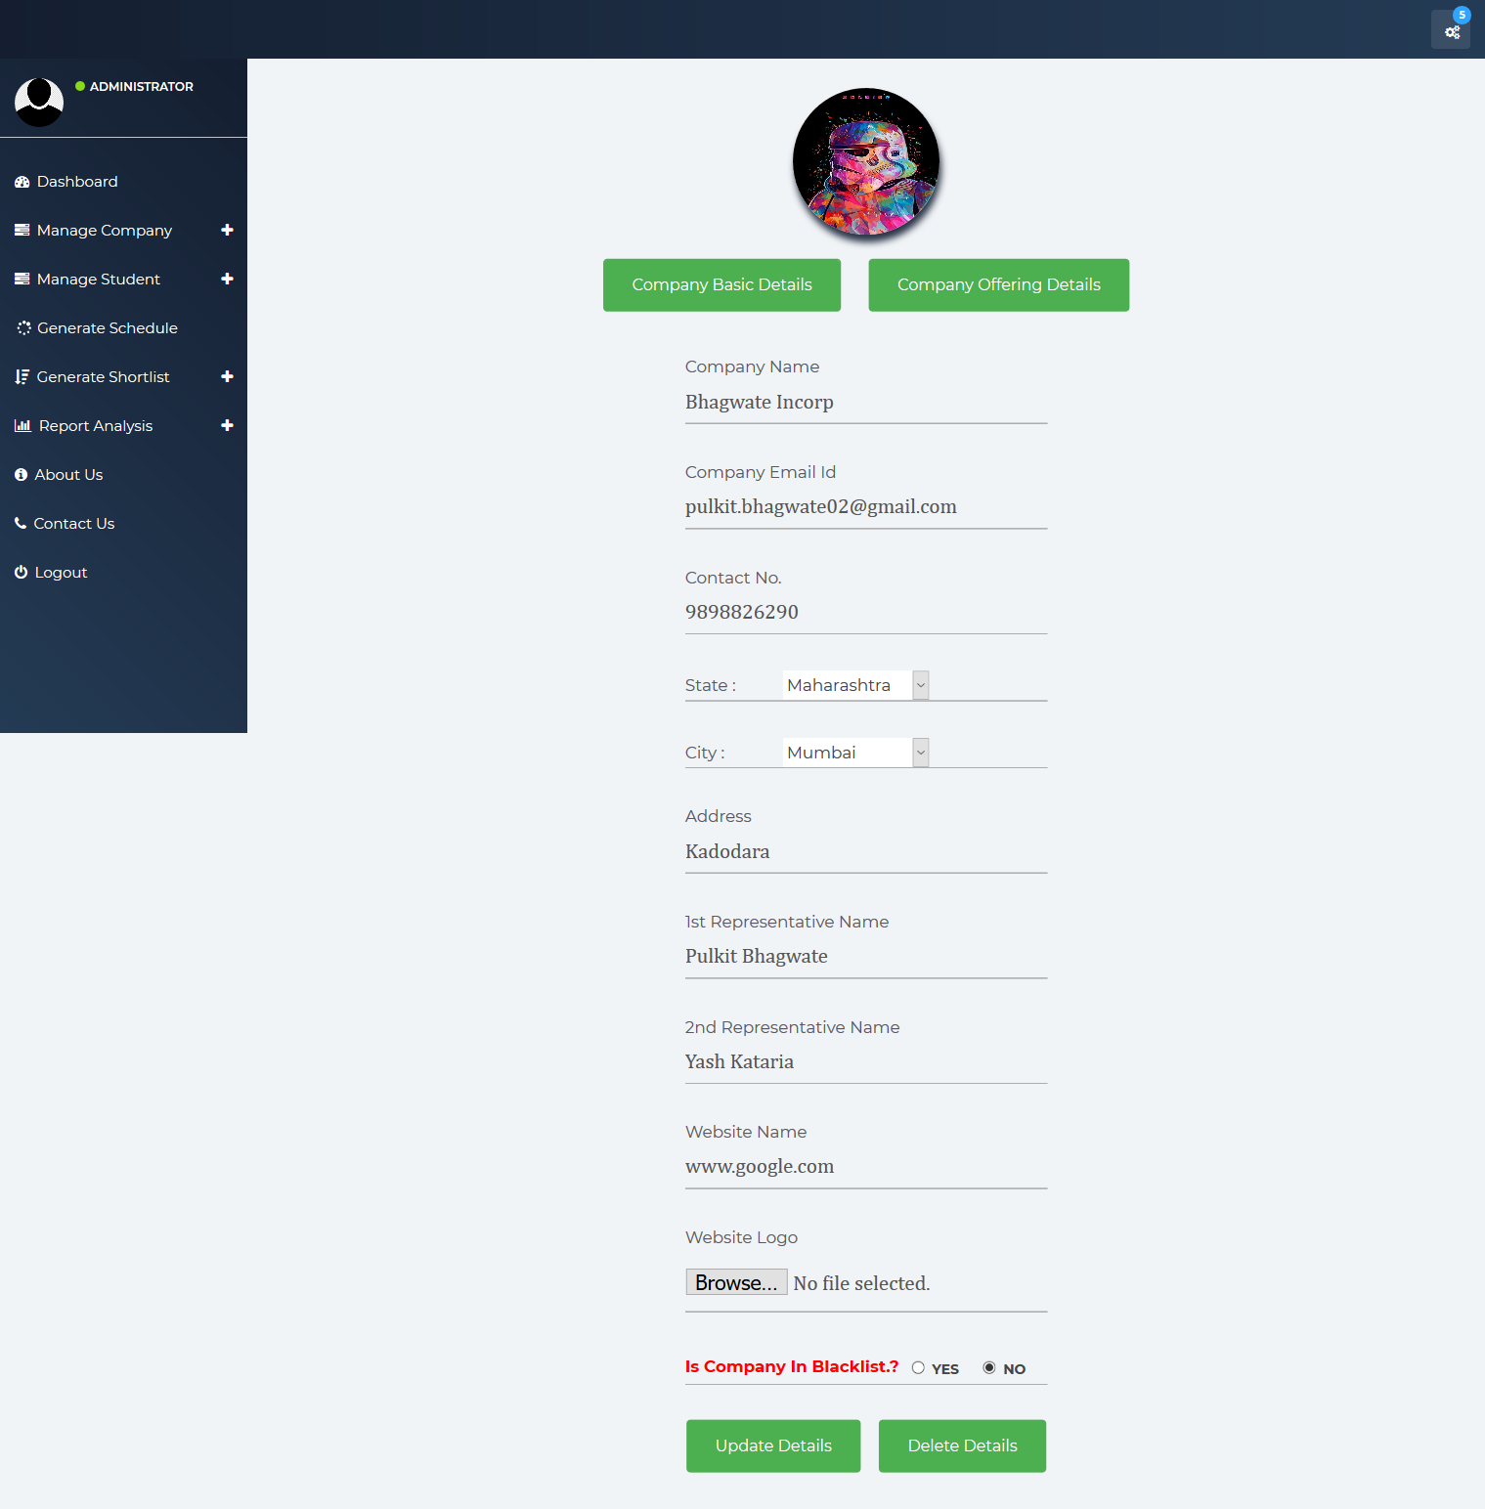
9. Manage Profile’s Basic Details(Admin Side)

Slide 35
10. Manage Profile’s Offering Details(Admin Side)

Slide 36
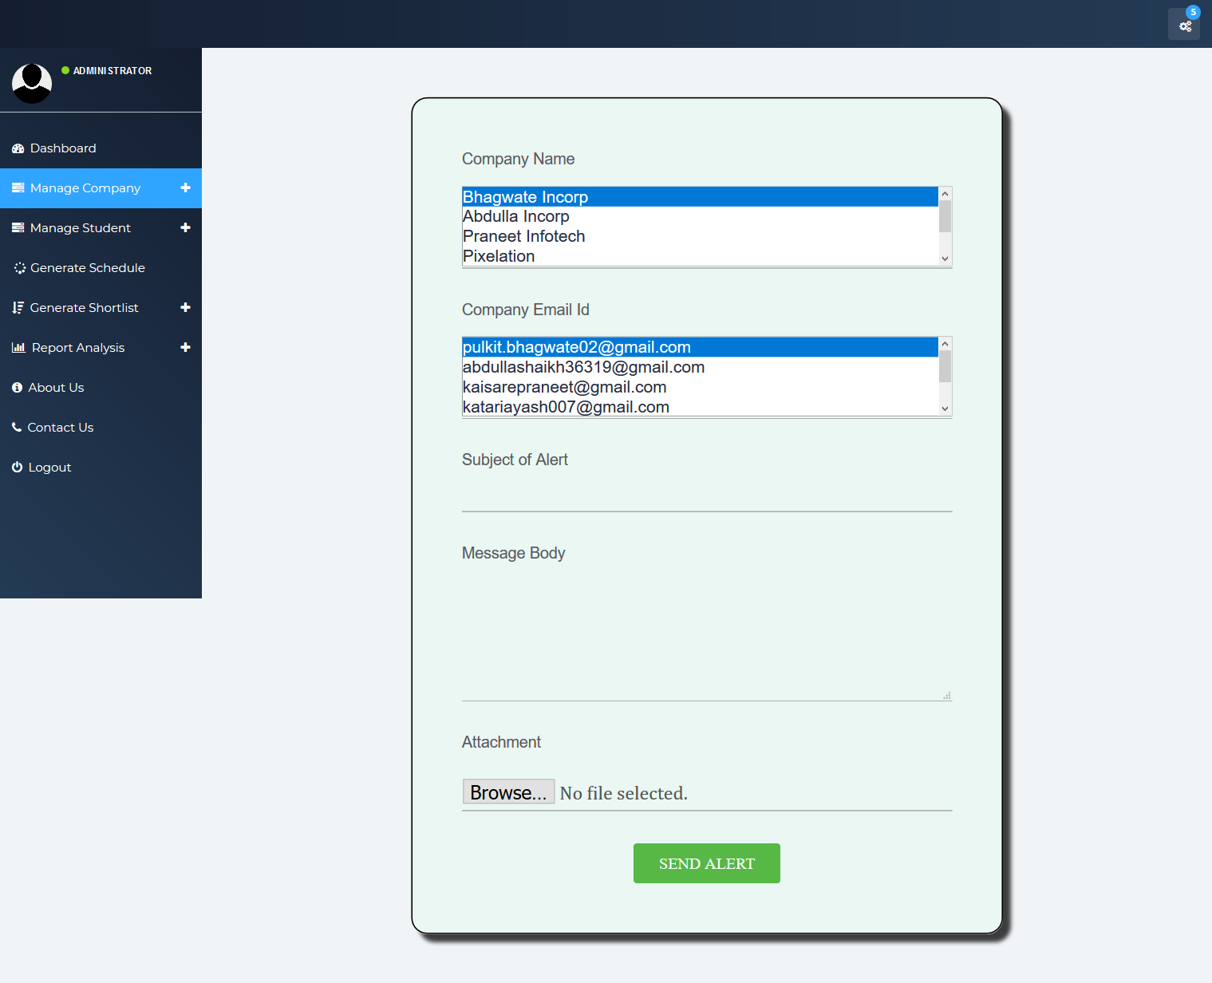
11. Configure Alert(Admin Side)

Slide 37
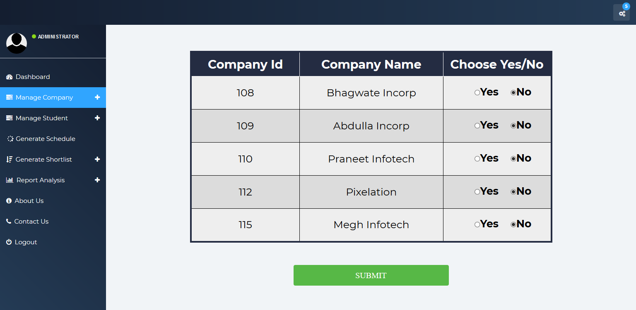
12. Blacklist Configuration(Admin Side)

Slide 38
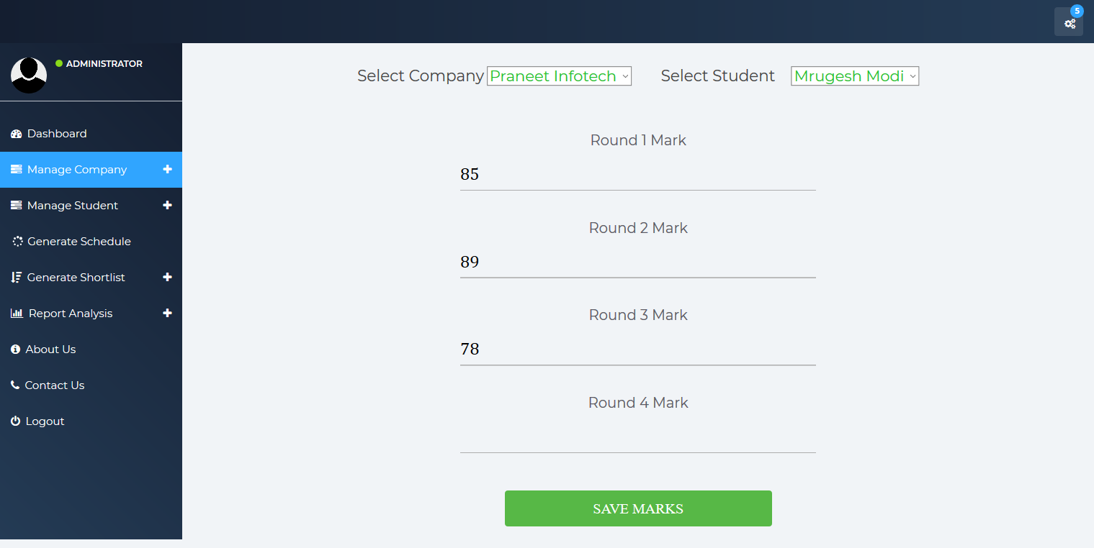
13. Interview Round Marks (Admin Side)

Slide 39
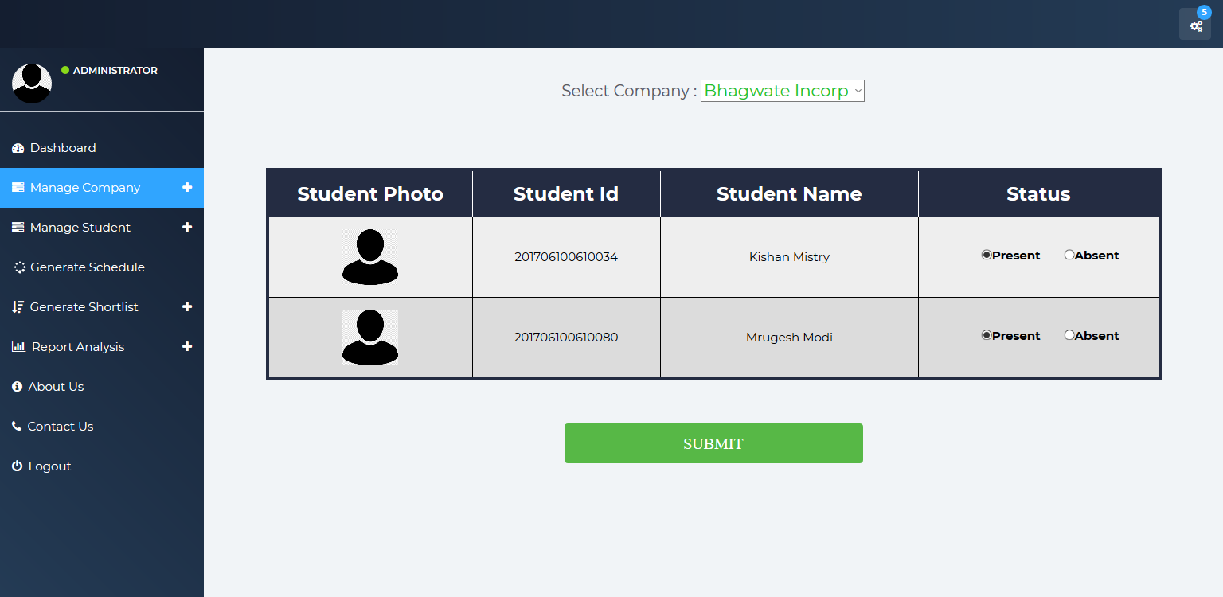
14. Interview Attendance(Admin Side)

Slide 40
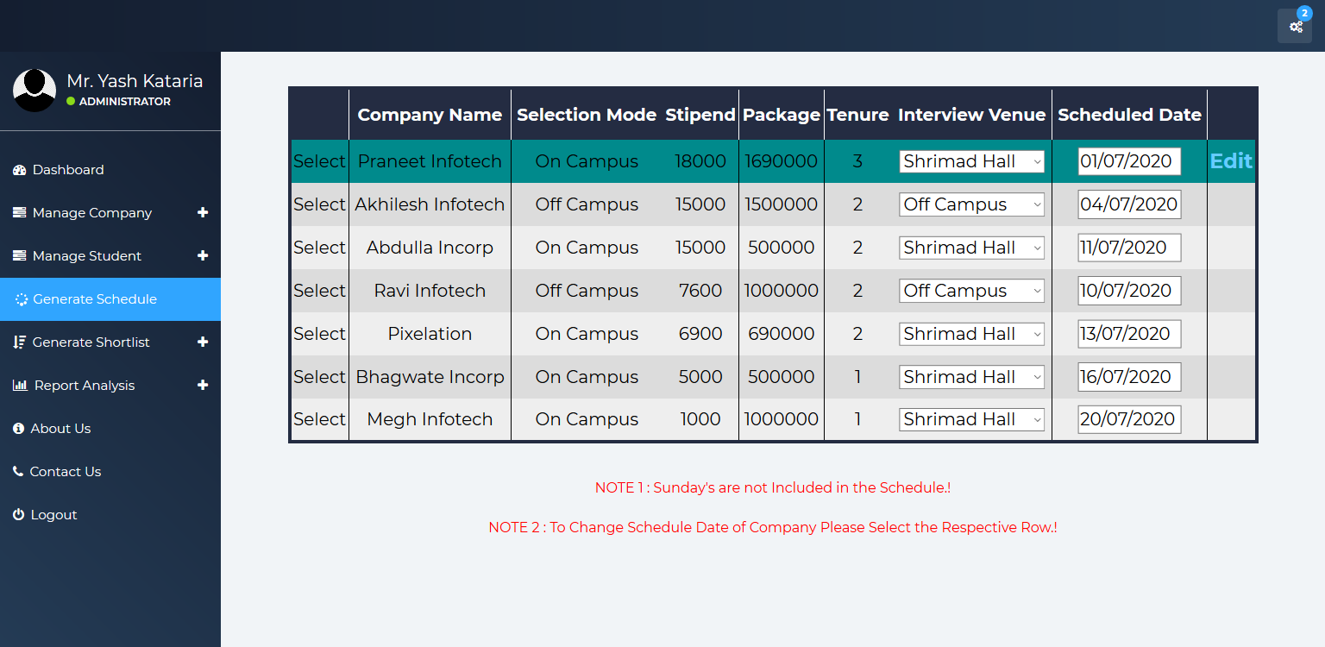
15. Generate Schedule(Admin Side)

Slide 41
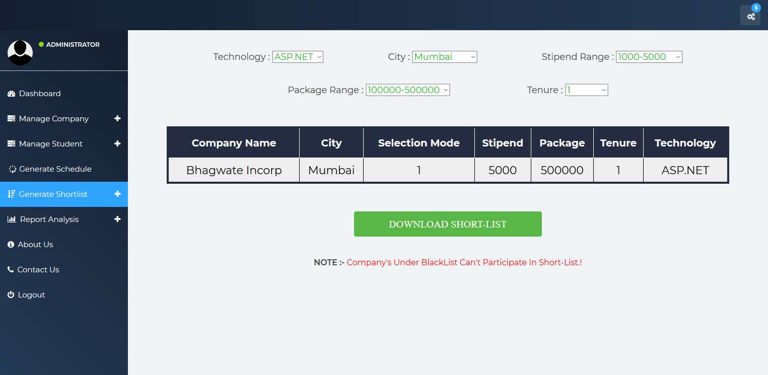
16. Company Short-List(Admin Side)

Slide 42
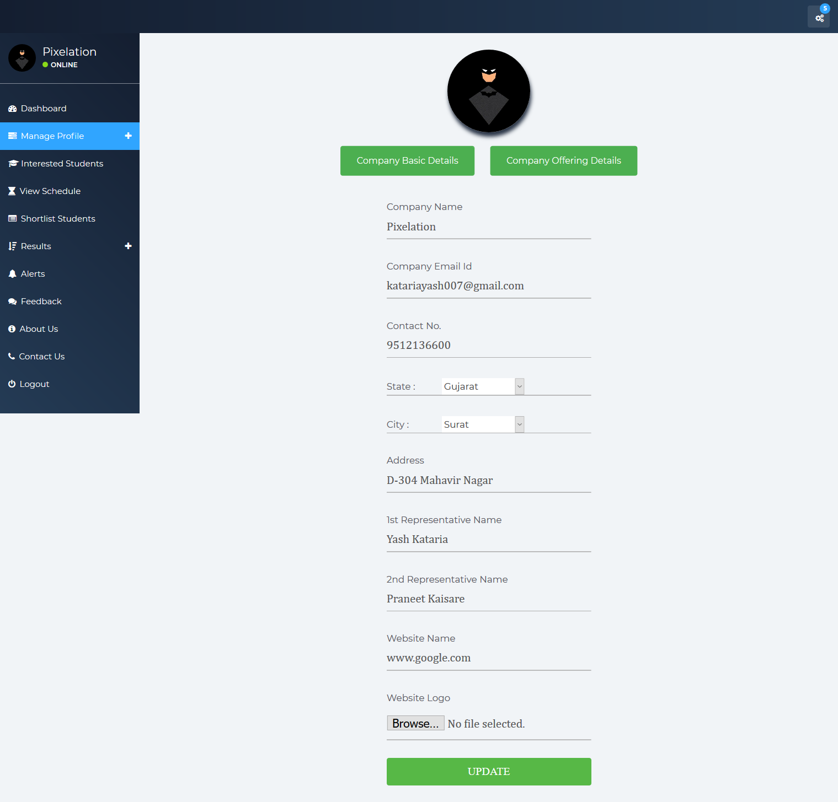
17. Company Update Profile(Company Side)

Slide 43
18. Company Offering Page(Company Side)

Slide 44
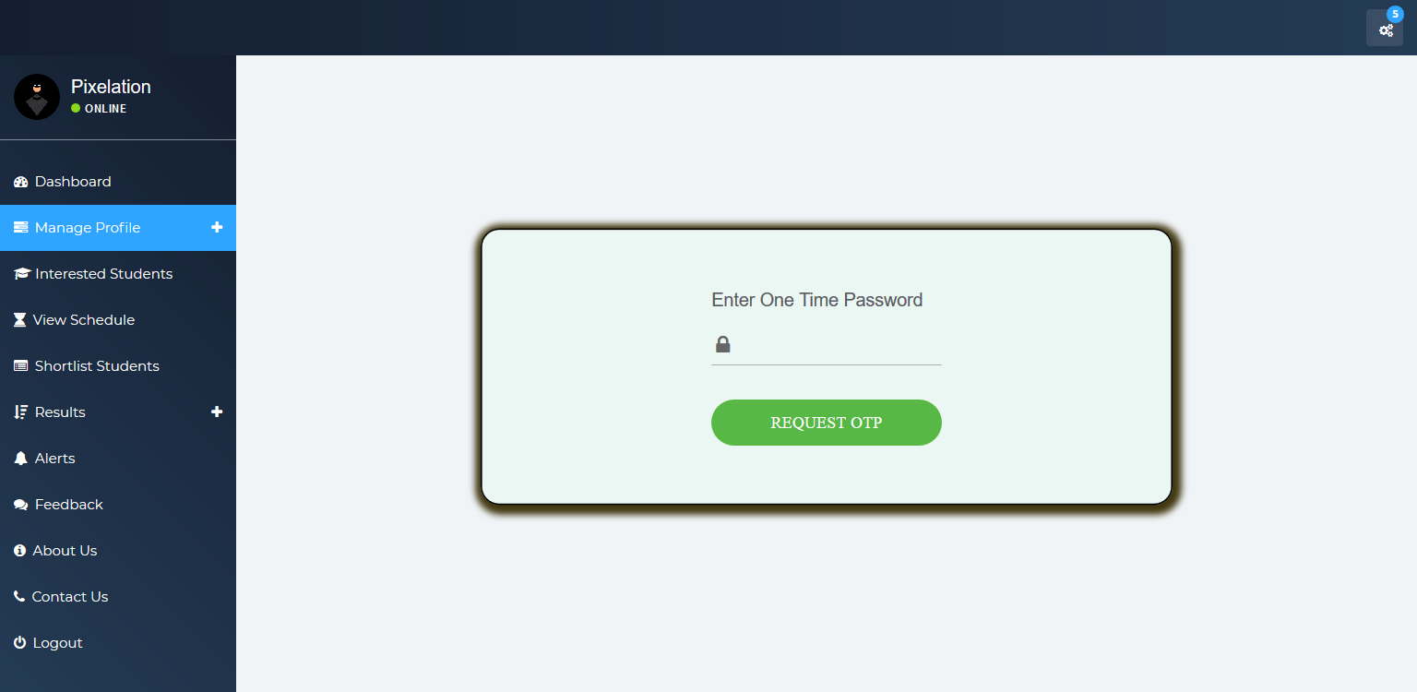
19. Change Password(Company Side)

Slide 45
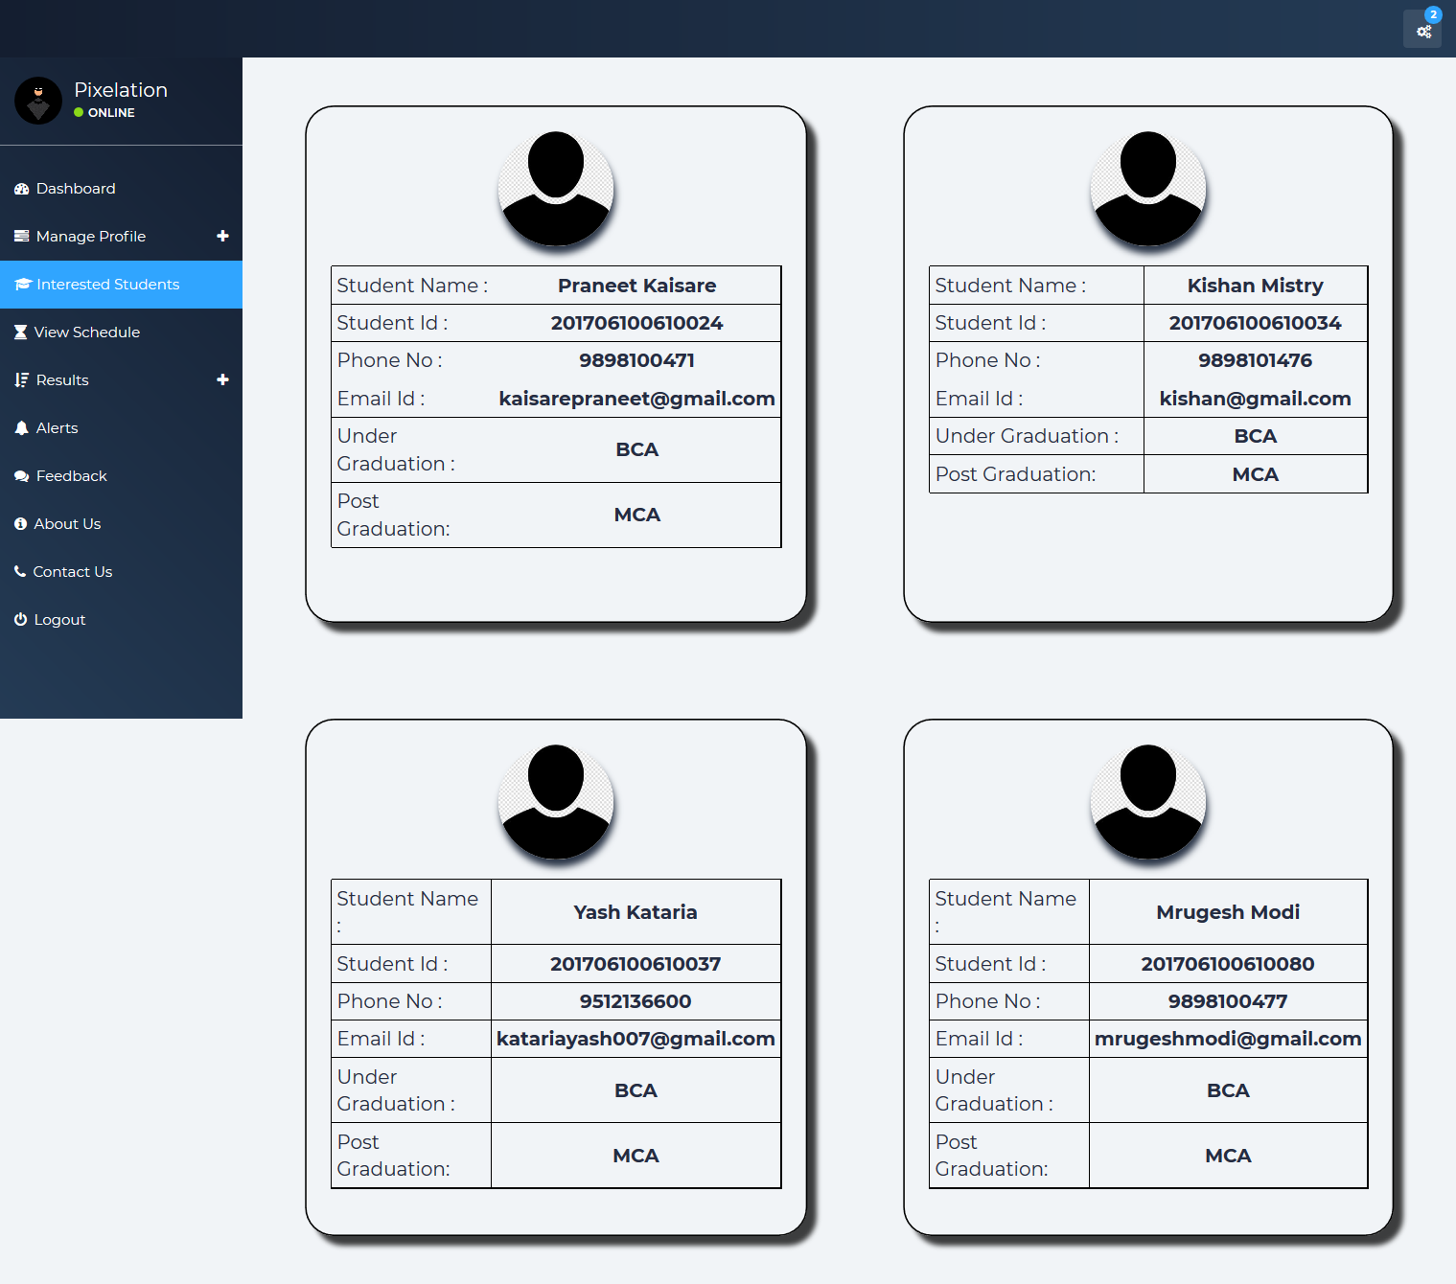
20. Interested Students(Company Side)

Slide 46
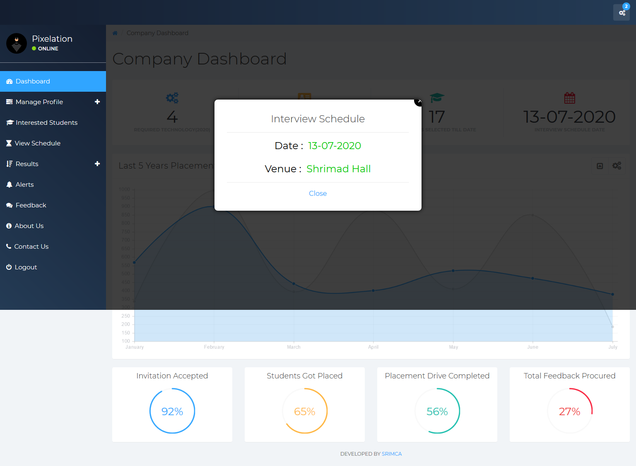
21. View Schedule(Company Side)

Slide 47
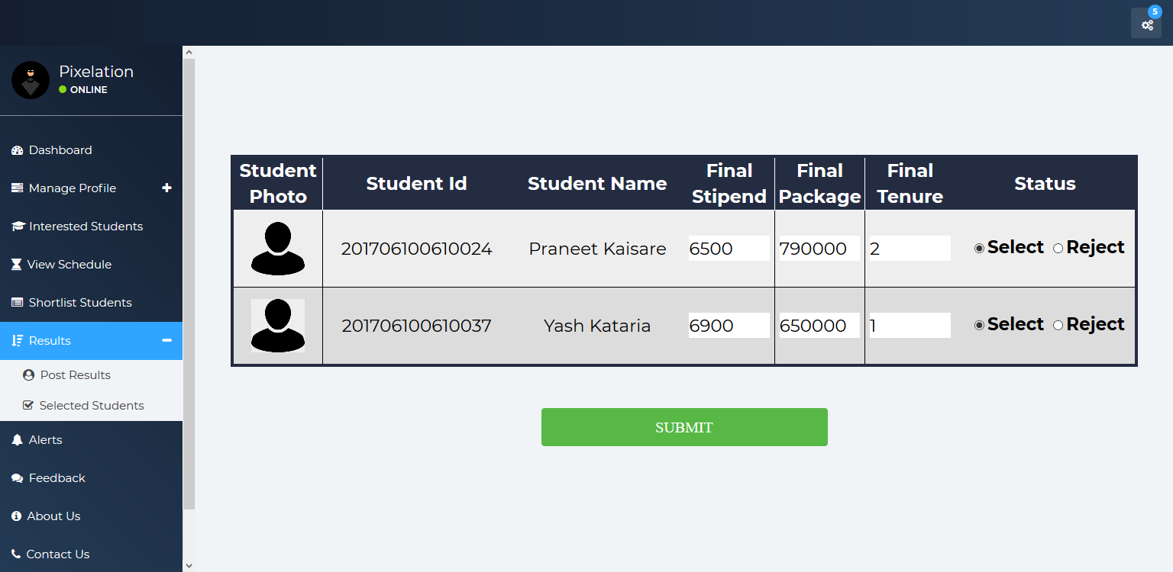
22. Post Results(Company Side)

Slide 48
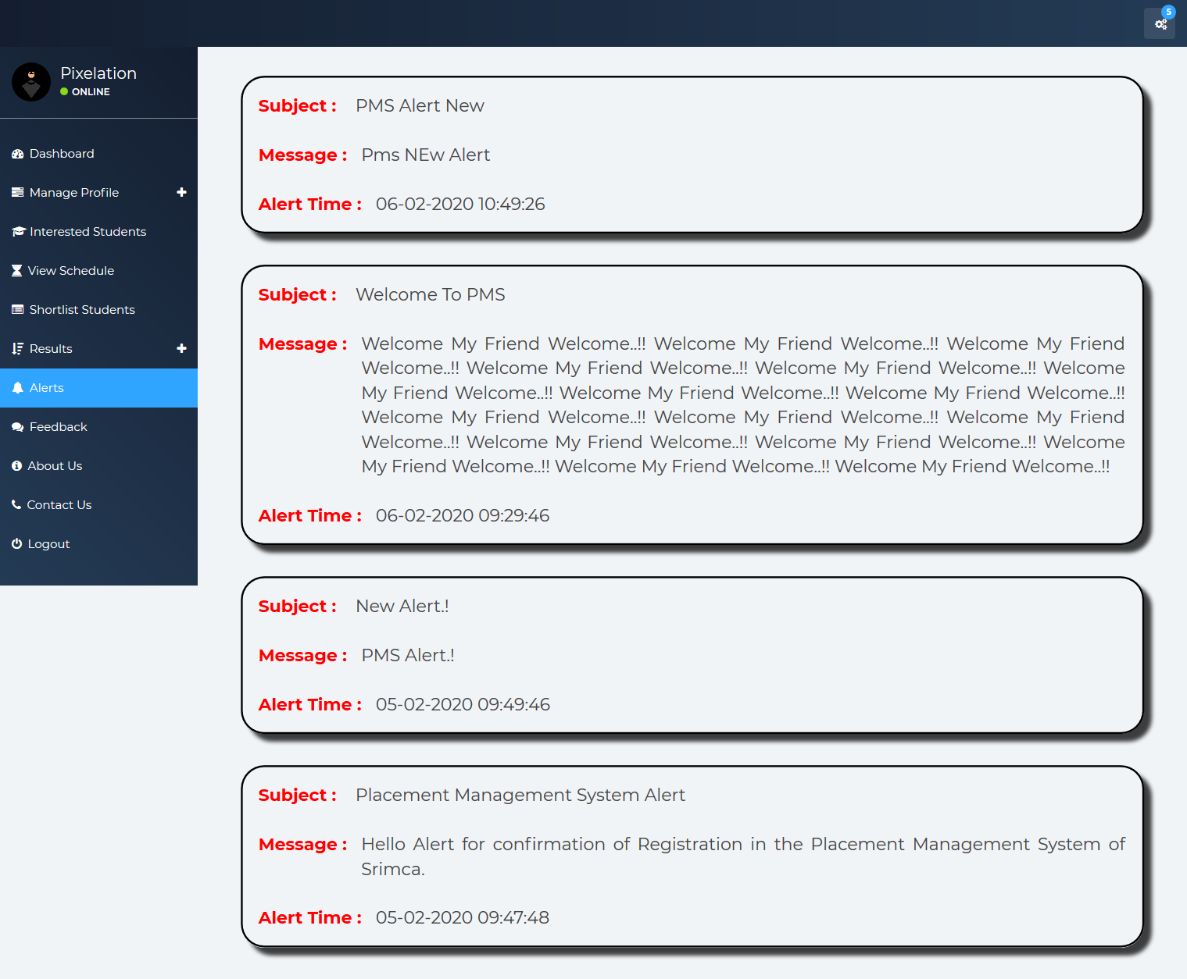
23. Alerts(Company Side)

Slide 49
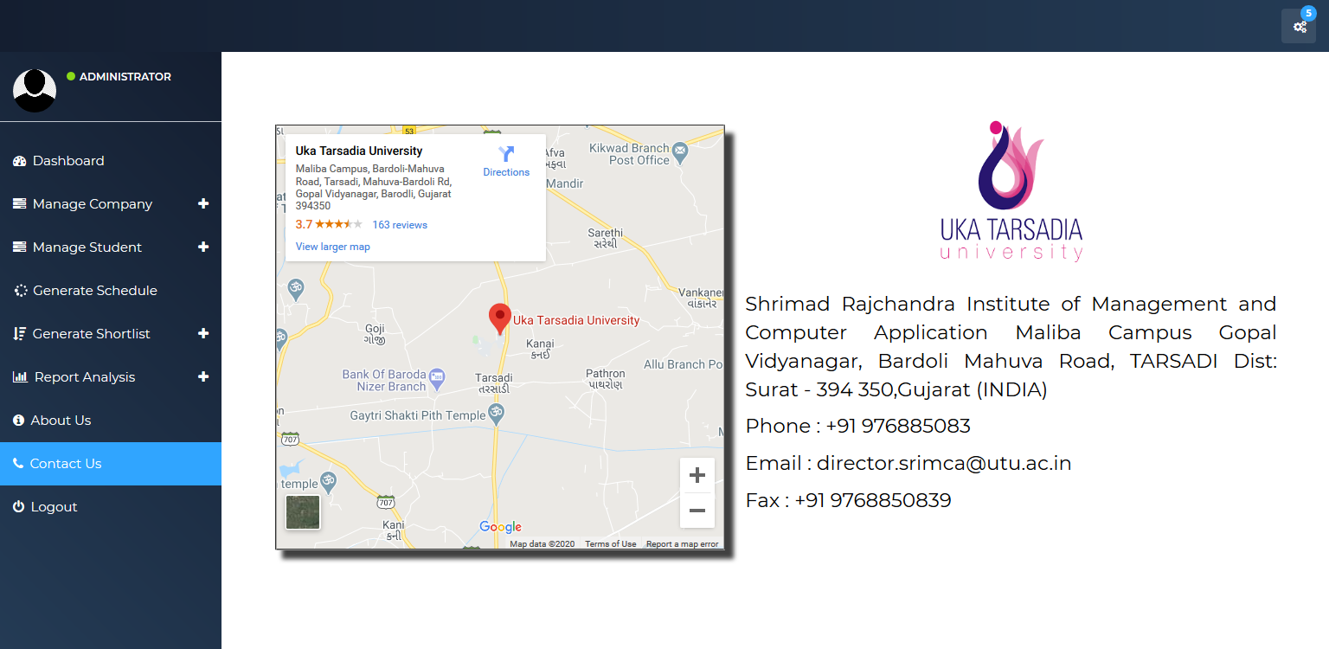
24. Contact Us(Admin Side)

Slide 50
25. About Us(Admin Side)

Slide 51
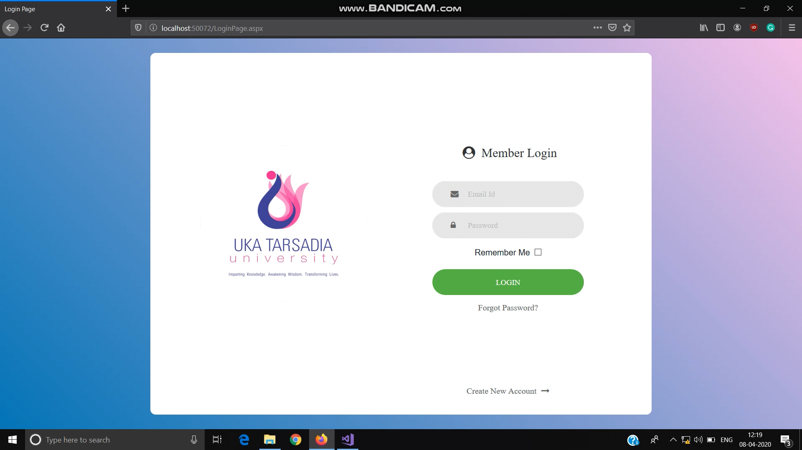
Demonstration : Admin Side

Slide 52

Demonstration : Company Side

Slide 53
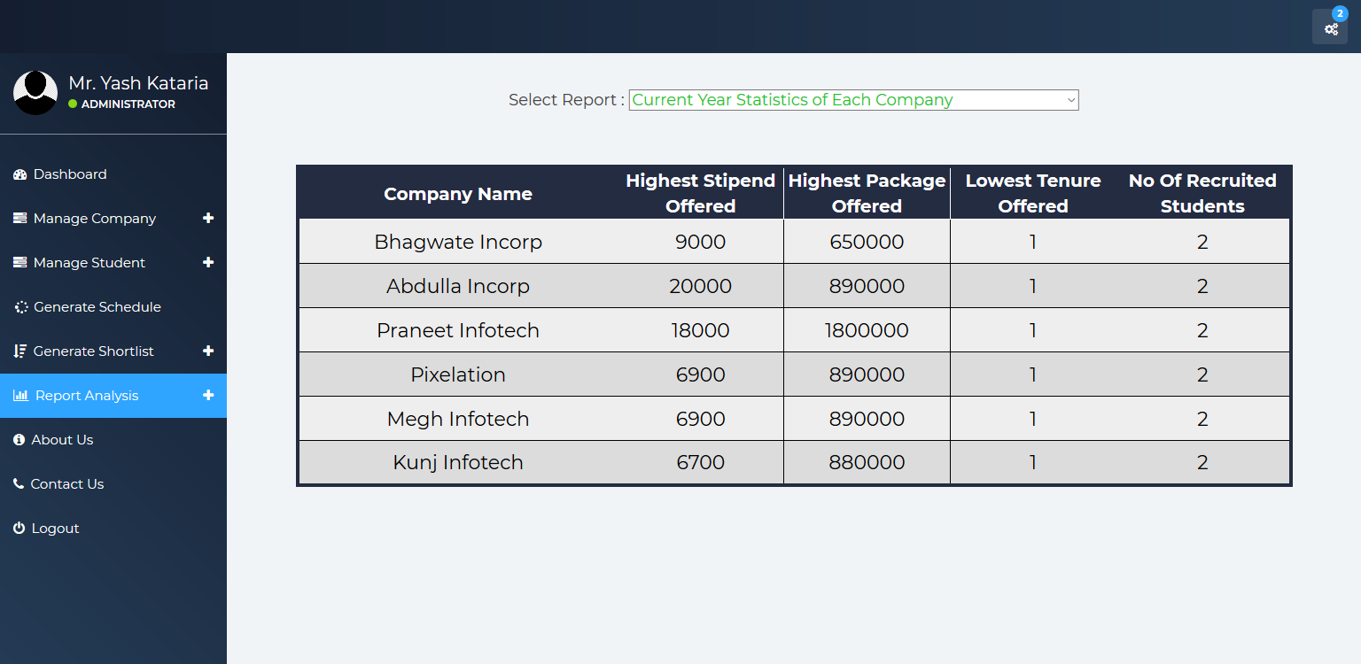
Reports 1. Current Year Statistics of Each Company

Slide 54
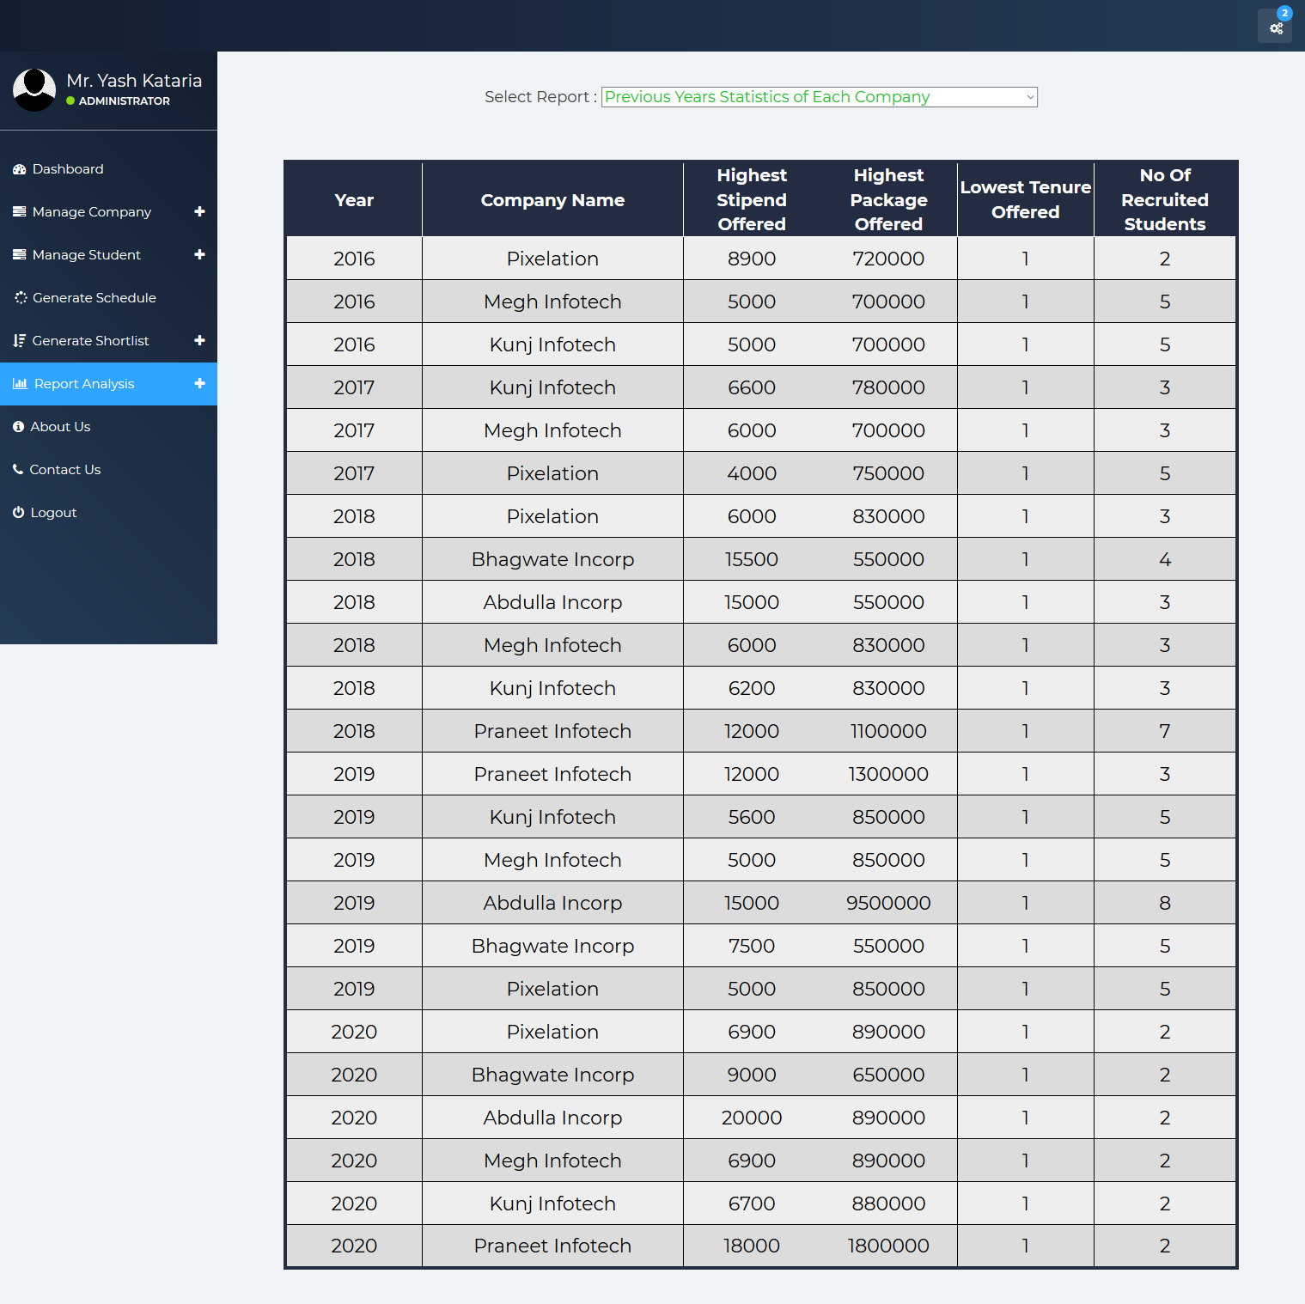
2. Previous Years Statistics of Each Company

Slide 55
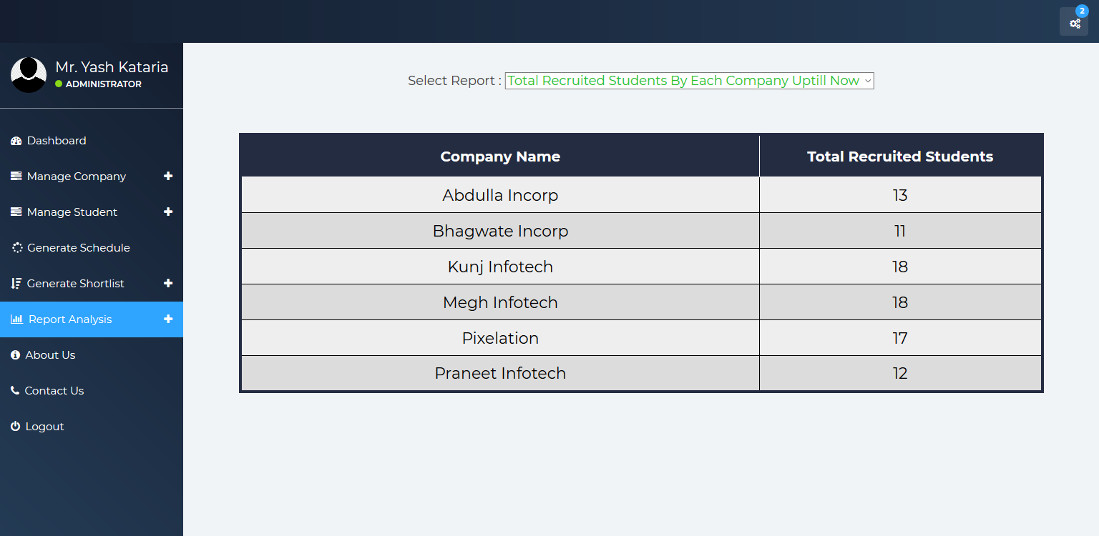
3 . Total Recruited Students By Each Company Untill Now

Slide 56
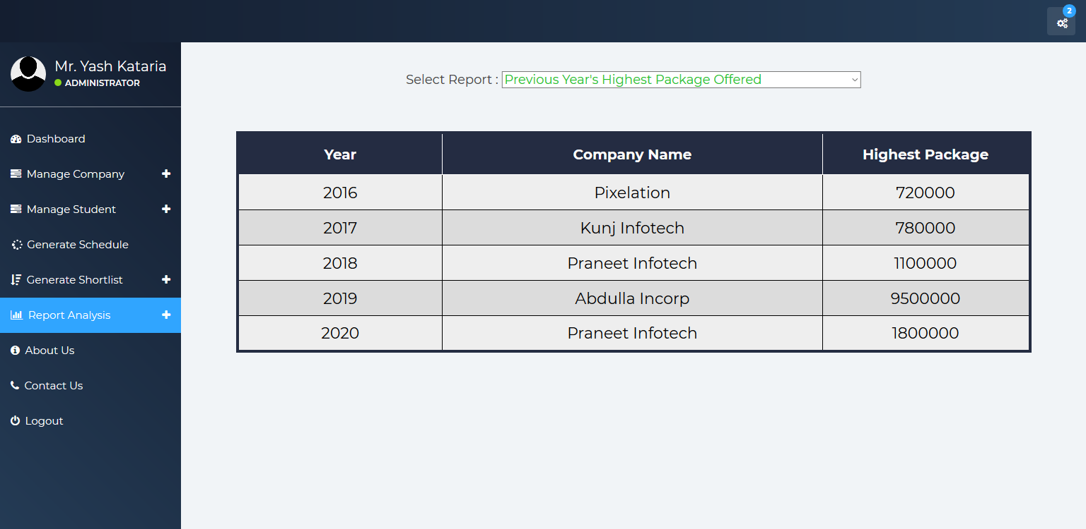
4 . Previous Year’s Highest Package Offered

Slide 57
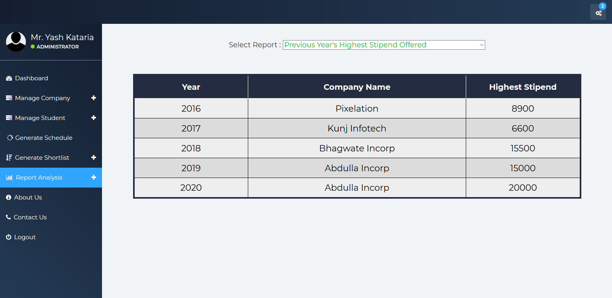
5 . Previous Year’s Highest Stipend Offered

Slide 58
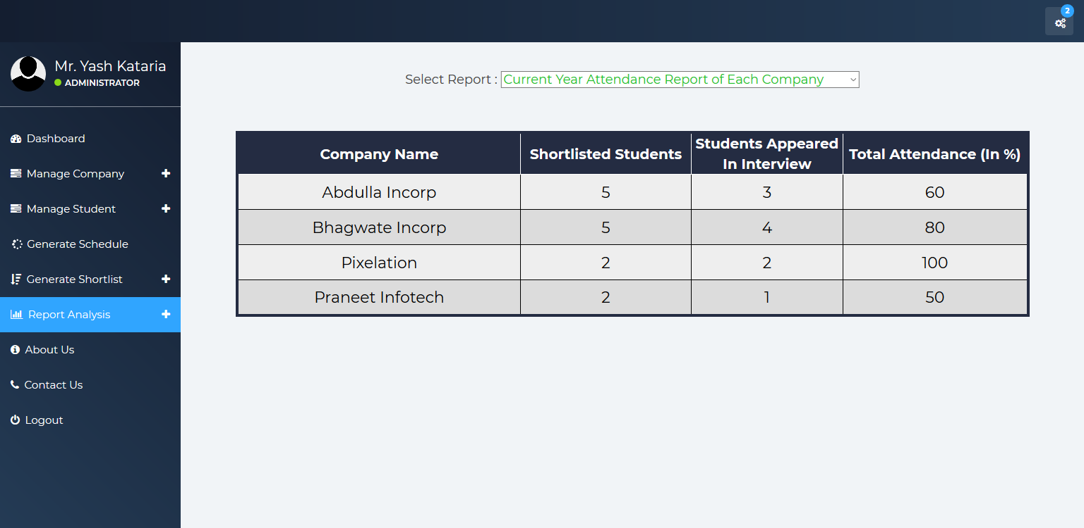
6 . Current Year Attendance Report of Each Company

Slide 59
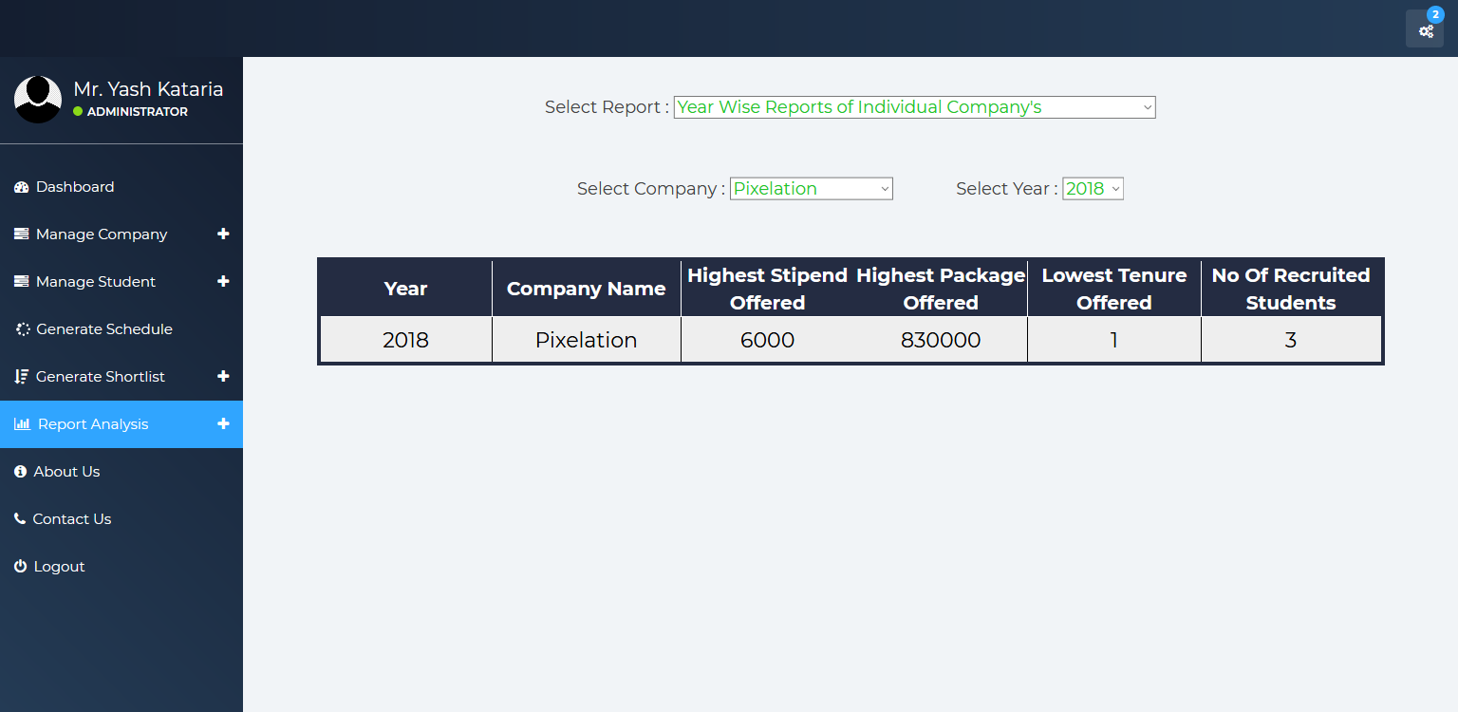
7 . Year Wise Reports of Individual Company’s

Slide 60
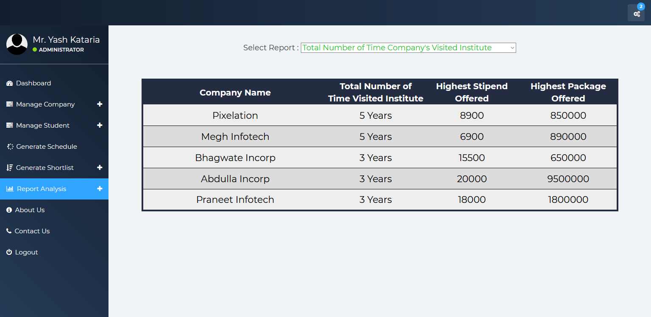
8. Total Number of Time Company’s Visited Institute

Slide 61
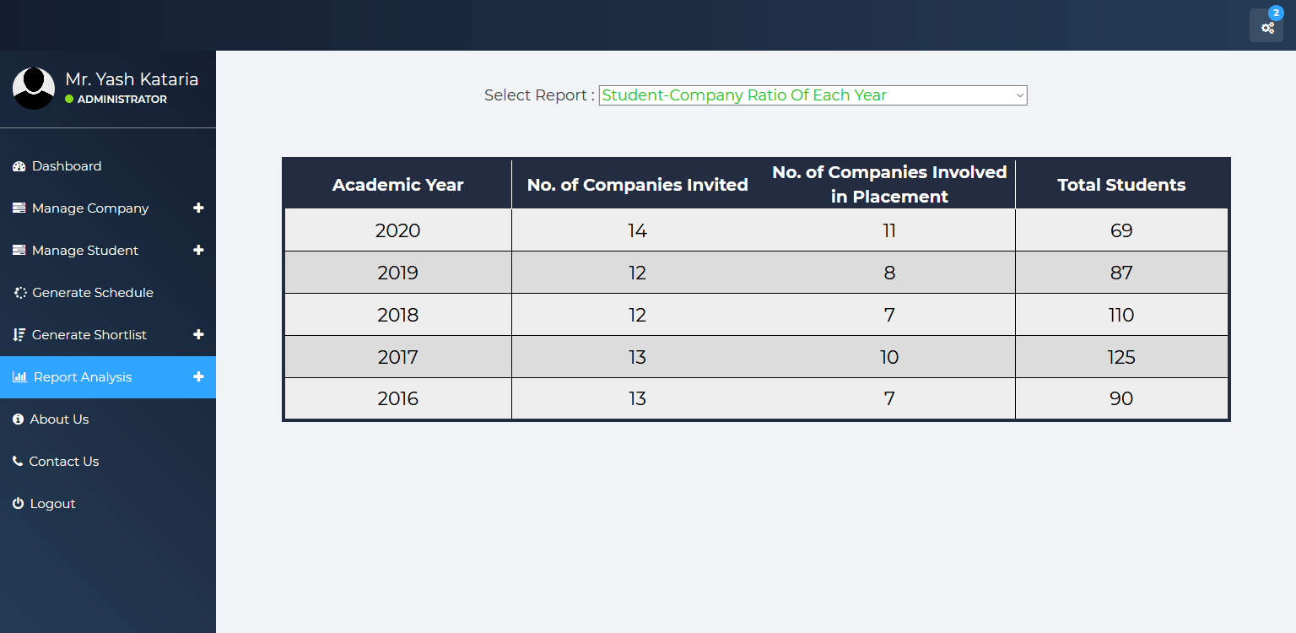
9. Student-Company Ratio of Each Year

Slide 62
References
Web references
https://docs.microsoft.com/enus/dotnet/csharp/programming-guide/inside-aprogram/coding-conventions
https://docs.microsoft.com/enus/dotnet/standard/design-guidelines/
https://docs.microsoft.com/en-us/aspnet/tutorials
https://www.guru99.com/software-testing.html
https://www.toolsqa.com/software-testing/test-case-specification/
https://www.guru99.com/testing-tools.html
https://www.hitex.com/tools-components/test-tools/test-case-specification/
https://www.tutorialspoint.com/software_testing_dictionary/test_tools.htm

Slide 63
Thank You.!

